Slide 1
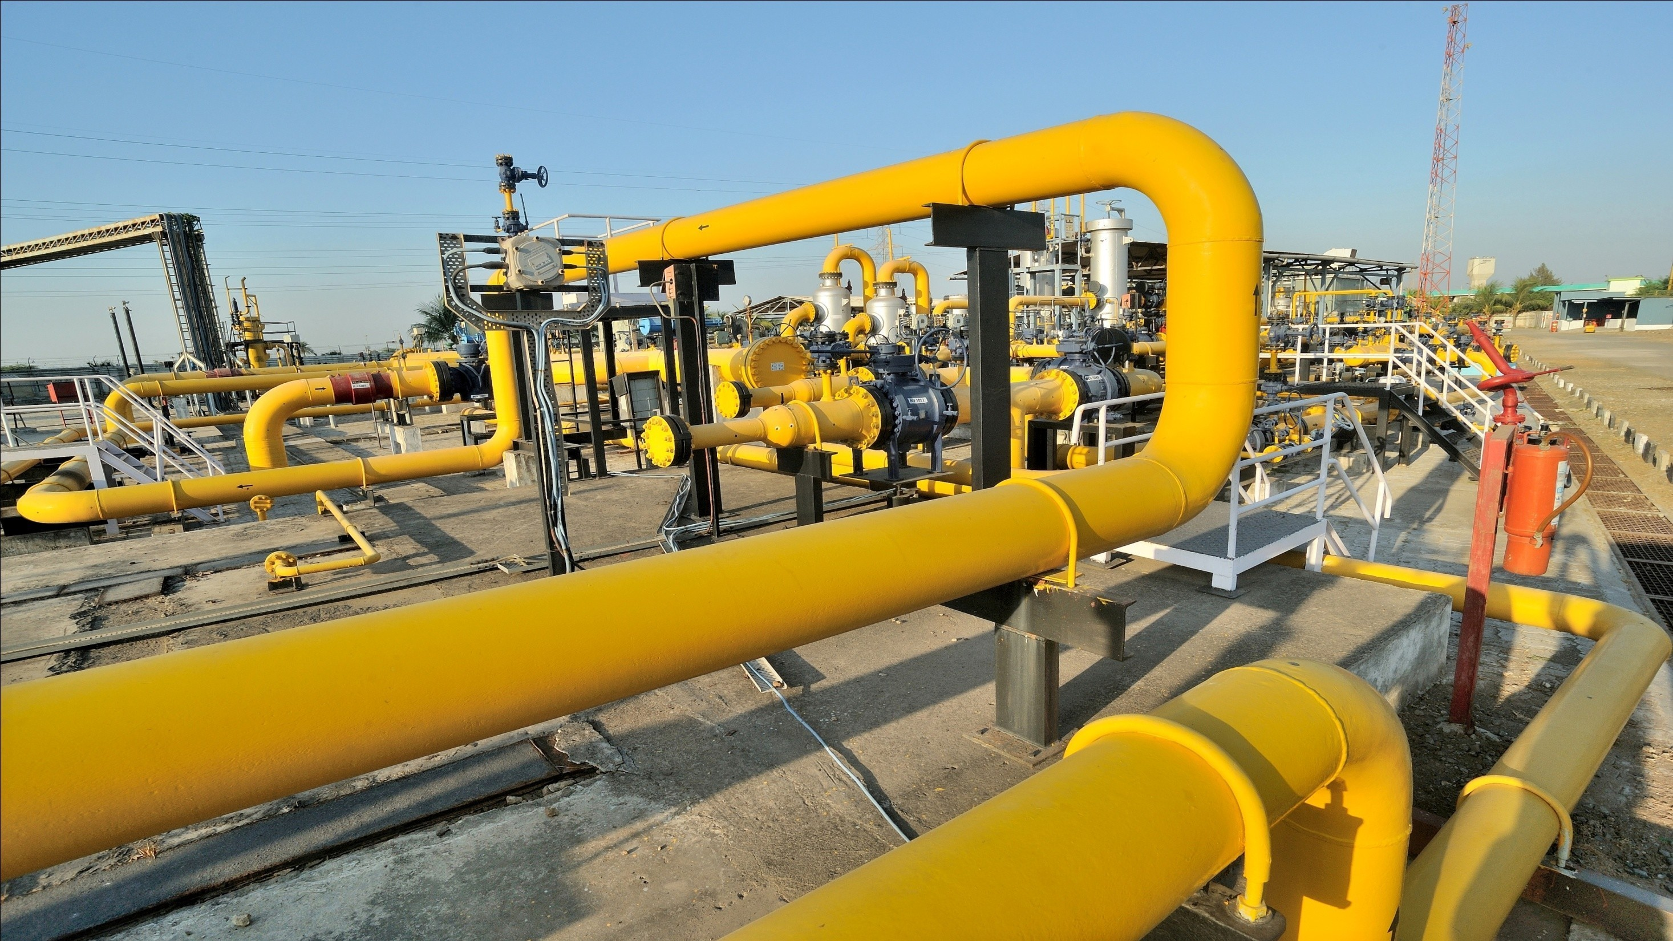


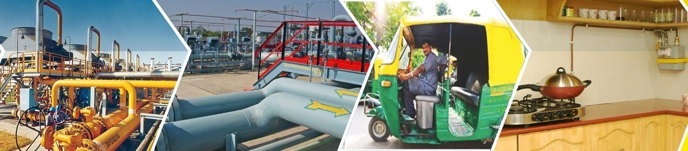
PETROLEUM AND NATURAL GAS REGULATORY BOARD
11th City Gas Distribution (CGD) Bidding Round

Slide 2

Contents
Natural Gas as a Fuel
CGD Business
9th & 10th CGD Bidding Rounds – A Grand Success
11th CGD Bidding Round
Bidding Schedule

Slide 3
Contents
Natural Gas as a Fuel
CGD Business
9th & 10th CGD Bidding Rounds – A Grand Success
11th CGD Bidding Round
Bidding Schedule

Slide 4






Why Natural Gas?
Enabler to meet
country’s COP26 commitments on Carbon emissions
Environment friendly
GAS
USAGE
Cheaper than LPG for domestic households
Cheaper than liquid fuels such as Petrol and Diesel
Recent discoveries are more of Natural Gas than oil ensuring energy security to India

Slide 5
Natural Gas Consumption in India
Gas Consumption and its share in Energy Mix
Natural Gas Share in Energy Mix (2020)
Gas consumption linked to domestic gas availability, LNG affordability and infrastructure
In the state of Gujarat, share of natural gas in energy mix is 26%
The per capita consumption of NG in India only around 29 SCM as compared to the world average of 363 SCM
NG share in India’s energy mix far below global average – room for growth
Source: PNG Stat, PPAC, BP Stats, MOSPI-Energy Statistics 2021, GIDB

Slide 6
Gas Sales in India
Gas Sales in SEPTEMBER 2021 (5.5 BCM) | Gas Consumption FY 2020-21 (MMSCM)
Source: PPAC India
Consumption of Natural Gas with a volume of 5.5 BCM during the month of September 2021 recorded a growth of 7.9% over the volume of 5.1 BCM in the month of September 2020.

Slide 7

PNGRB – Current Focus
Increase share of Natural Gas in India’s Energy basket
Create infrastructure to support higher consumption of Natural Gas in India
Establish a transparent and vibrant Natural Gas market in India
Balance the interests of Consumers, Transporters and Producers of Natural Gas

Slide 8
Contents
Natural Gas as a Fuel
CGD Business
9th & 10th CGD Bidding Rounds – A Grand Success
11th CGD Bidding Round
Bidding Schedule

Slide 9
CGD Network - Business
Financial Closure
Build pipelines from the gas supply source to the GA
Lay pipelines for the domestic customers
Build CNG stations
Exclusive right in the GA to supply:
  PNG to domestic customers
  CNG to vehicles

Slide 10
Development of CGD Network

Slide 11
Development of CGD Network
Authorizations | No. of GAs | % Share in respect of India
 |  | Area | Population
Pre-PNGRB | 31 | 3.02 % | 9.67 %
Section - 42 | 6 | 0.61 % | 1.57 %
Rounds 1 to 8 | 55 | 7.23 % | 8.83 %
Round 9 | 86 | 23.82 % | 26.38 %
Round 10 | 50 | 17.92% | 24.23%
Total | 228 | 52.60% | 70.68%

Slide 12
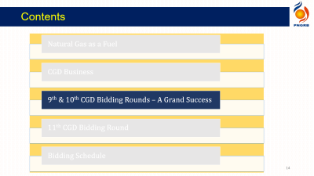
Status of Natural Gas Infrastructure
228 Operational Geographical Areas (As on 30.09.2021)
Area : 17 Lakh Sq. kms (53% of India)
Population : 85 Crore (70% of India)
Domestic consumers : 82.17 Lakh
CNG Stations : 3,465
Commercial Customers : 33,294
Industrial Customers : 12,527
Gas Sale : 30 MMSCMD
CGD Pipelines-steel : 1.09 Lakh Inch-km
CGD Pipelines- MDPE : 2.19 Lakh Inch-km

Slide 13
Status of Natural Gas Infrastructure
Natural Gas Pipelines (As on 30.09.2021)
In Operation 20,239 km
Under Construction 14,930 km
LNG Terminals
Existing Capacity – 37.5 MMTPA
Upcoming – 34 MMTPA
Upcoming Terminals
  Chhara
  Dhamra
  Digha
  Gangavaram
  Jafrabad
  Jaigarh
  Kakinada

Slide 14
Contents
Natural Gas as a Fuel
CGD Business
9th & 10th CGD Bidding Rounds – A Grand Success
11th CGD Bidding Round
Bidding Schedule

Slide 15
9th & 10th CGD Bidding Round – Key Highlights
 | 9th Round | 10th Round | Total
GAs offered | 86 | 50 | 136
States/ UTs | 22 | 14 | 23
Districts covered | 174 (156 full and 18 parts) | 124 (112 full and 12 parts) | 298 (268 full 30 parts)
Area (%) | 23.8 | 17.9 | 41.7
Population (%) | 26.4 | 24.2 | 50.6
Investors’ Response
No. of bids received | 406 | 225 | 631
Number of entities participated | 38 | 25 | 41
Minimum Work Program
PNG Domestic Connections | 221 Lakh | 202 Lakh | 423 Lakh
CNG Stations | 4,603 | 3,578 | 8,181
Steel Pipeline (Inch-km) | 1.16 Lakh | 0.58 Lakh | 1.74 Lakh

Slide 16
Contents
Natural Gas as a Fuel
CGD Business
9th & 10th CGD Bidding Rounds – A Grand Success
11th CGD Bidding Round
Bidding Schedule

Slide 17
11th CGD Bidding Round – Key Features
Covers 33% of India’s area and 26% of its population
Post‐11th CGD Bidding Round
17 States – Andhra Pradesh, Goa, Gujarat, Haryana, Karnataka, Kerala, Punjab, Rajasthan, Tamil Nadu, Telangana, Odisha, Maharashtra, Chhattisgarh, Himachal Pradesh, Madhya Pradesh, Tripura and Uttarakhand along with 3 UTs – Delhi, Chandigarh and Dadra Nagar Haveli & Daman and Diu will be fully authorized for development of CGD Network.
Expected Employment : ~ 86,000 manpower
Expected investment : ~ ₹ 83,000 Crore
65 Geographical Areas (GAs) offered, covering 208 districts (206 full and 2 part)
Spread over 19 States and 1 UT

Slide 18
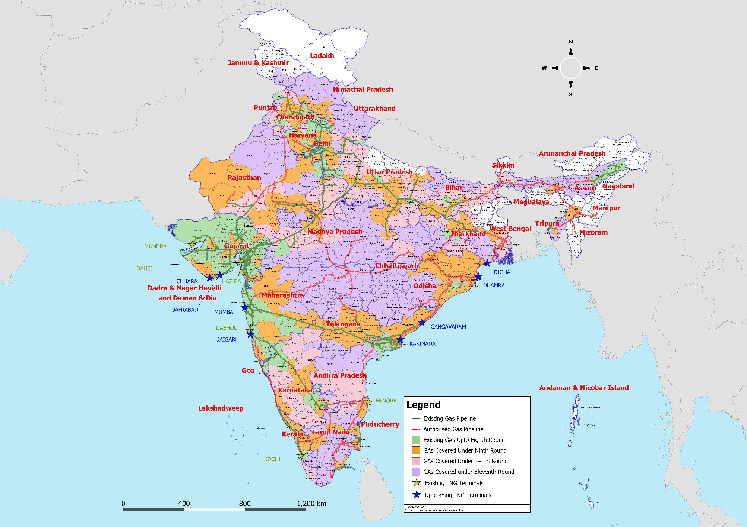
Gas Infrastructure of India - 2021

Slide 19
Key Policy Enablers
Regulatory interventions
      CNG in public transport in certain cities
      Ban on Petcoke and FO - Delhi, Haryana, Uttar Pradesh and Rajasthan
Domestic gas allocation for Domestic PNG and CNG
State governments’ commitment for facilitation of CGD Networks:
    Nodal officer, Single Window Clearance
    Standard restoration charges by Municipalities
    State Road Transportation on CNG
    Land for CNG Stations

Slide 20
11th CGD Bidding Round
Validated by enthusiastic participation in the 9th and 10th CGD Bidding Round, all its features retained in the 11th CGD Bidding Round
All GAs on or near existing or under‐construction Natural Gas Pipelines
Electronic Bidding
Investor‐friendly Regulations
Gas pipeline operator to provide connectivity to CGD Network within 180/270 days

Slide 21
11th CGD Bidding Round
Exclusivity of 8 years (extendable up to 10 years for performers)
Infrastructure Exclusivity for 25 years continues
Level playing field and Easy eligibility criteria
Performance Bank Guarantee capped at Rs. 50 Crore
Time for Financial Closure increased to 270 days from earlier 180 days

Slide 22
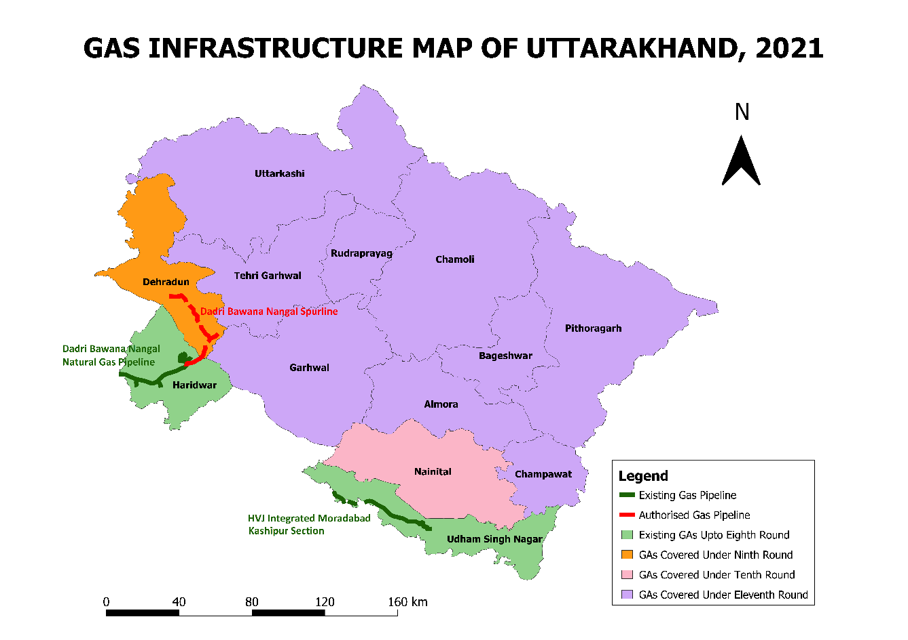
Uttarakhand : GAs Offered in 11th Round
2 GAs covering 9 districts offered under 11th round
Districts covered up to 10th round
Udham Singh Nagar
Haridwar
Dehradun
Nainital
GA No. | Districts Covered
11.64 | Pauri Garhwal, Uttarkashi, Rudraprayag and Tehri Garhwal
11.65 | Pithoragarh, Champawat, Almora, Chamoli and Bageshwar

Slide 23
Uttarakhand : GAs Offered in 11th Round
Name of GA | District(s) | Population | No. of Charge Areas | Total Households | Area (Sq. km.)
11.64 : Pauri Garhwal, Uttarkashi, Rudraprayag and Tehri Garhwal | Pauri Garhwal | 687271 | 1 | 161145 | 5329
 | Uttarkashi | 330086 | 1 | 67452 | 8016
 | Rudraprayag | 242285 | 1 | 53400 | 1984
 | Tehri Garhwal | 618931 | 1 | 132258 | 3642

Slide 24
Uttarakhand : GAs Offered in 11th Round
Name of GA | District(s) | Population | No. of Charge Areas | Total Households | Area (Sq. km.)
11.65 : Pithoragarh, Champawat, Almora, Chamoli and Bageshwar | Pithoragarh | 483439 | 1 | 114362 | 7090
 | Champawat | 259648 | 1 | 53862 | 1766
 | Almora | 622506 | 1 | 140149 | 3144
 | Chamoli | 391605 | 1 | 88383 | 8030
 | Bageshwar | 259898 | 1 | 57941 | 2241

Slide 25
Eligibility Criterion - Technical
Eligibility Criterion
1. Authorized CGD entity independently or as a consortium or JV partner
3. Through a JV with 1 or 2 above with minimum 11 % stake
2. Entity having CGD or hydrocarbon minimum 300 km pipeline on its own or constructed for any entity

Slide 26
Eligibility Criterion - Financial
Minimum Net Worth of Entity:
Population in GA>=5 million – 1500 million plus 300 million for each million of population or part thereof
2 million >= Population in GA < 5 million – 1000 million
1 million >= Population in GA < 2 million – 750 million
0.5 million >= Population in GA < 1 million – 500 million
0.25 million >= Population in GA < 0.5 million – 250 million
0.1 million >= Population in GA < 0.25 million – 100 million
Population in GA < 0.1 million – 50 million
26

Slide 27
Weightages for Bid Evaluation
Quote for Transportation rate of CGD – Not to be less than Rs 30 per MMBTU
Quote for Transportation rate of CNG – Not to be less than Rs 2 per kg
Subsequent years rates would be adjusted for inflation based on WPI

Slide 28
Weightages for Bid Evaluation for GAs 11.64 & 11.65
Quote for Transportation rate of CGD – Not to be less than Rs 30 per MMBTU
Quote for Transportation rate of CNG – Not to be less than Rs 2 per kg
Subsequent years rates would be adjusted for inflation based on WPI

Slide 29
Contents
Natural Gas as a Fuel
CGD Business
9th & 10th CGD Bidding Rounds – A Grand Success
11th CGD Bidding Round
Bidding Schedule

Slide 30
Bidding Schedule
Press Release
16th Aug 2021
11th Round launch:
17th Sept 2021
Pre-bid conference :
18th Oct 2021
Bid Submission deadline:
15th Dec 2021
Technical bid opening:
17th -22nd Dec 2021
Financial bid evaluation
31st Jan-2nd Feb 2021
Award –
18th Feb 2022
Bid Submission and Opening on https://eprocure.gov.in/eprocure/app
Physical documents only for Bid Bond, Power of Attorney, Application Fee and Tender Fee

Slide 31
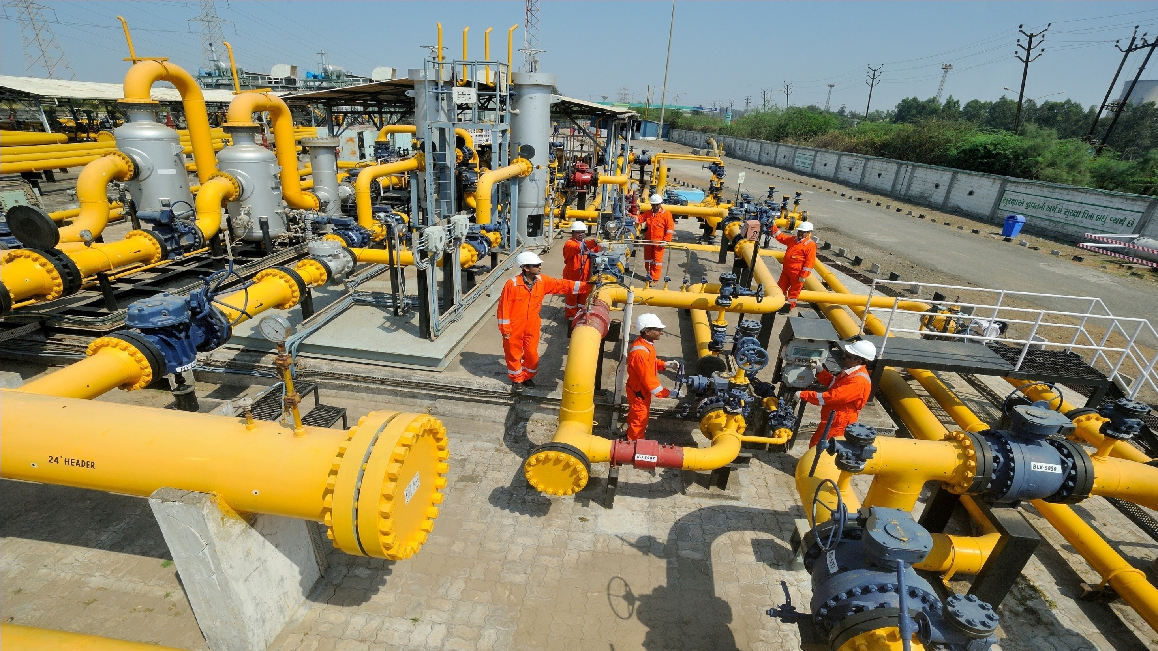

THANK YOU

